Slide 1
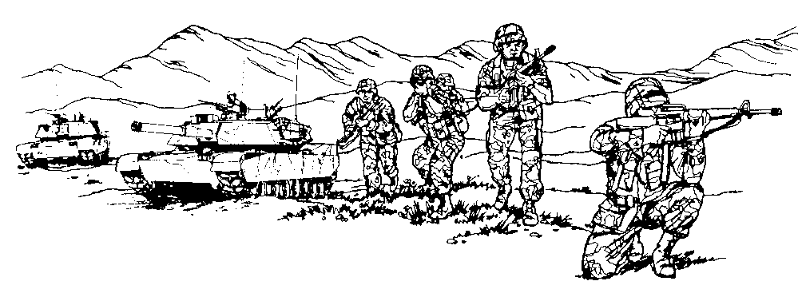
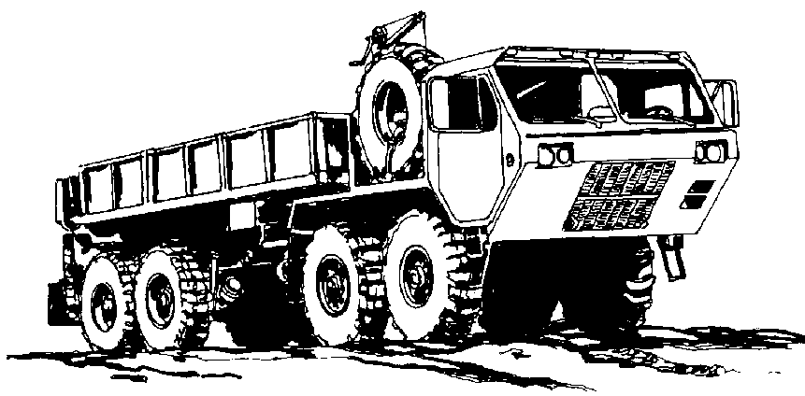
FIRST ARMY
CONVOY BATTLE DRILLS
CONVOY ATTACK MEASURES

Slide 2
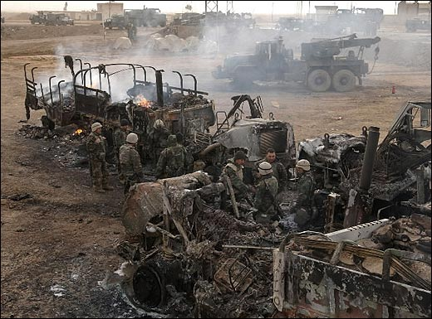
BATTLE DRILLS
Contact crew drill
Out of ammo or weapon jam
TC/AD combat battle drill
Entering/exiting the vehicle combat drill
React to contact
Convoy forced to stop
Break contact
Rally points
Recovery/CASEVAC Ops
Consolidation and Reorganization
Minefield
Unplanned Halt
Herringbones
Notes:
These are all the battle drills covered in the Convoy Leaders Handbook.

Slide 3
ACTIONS
1. Continuously scan
sectors
Place suppressive fire on
the enemy using weapon
engagement techniques and
proceed through the contact
zone increasing speed and
interval, and taking caution
not to bunch up.
3. Activate vehicle turn
signal to indicate direction of
contact (Primary)
4. Report contact on internal
communication, identifying
truck number, type of contact
and clock direction (Alternate)
1
2
REACT TO
ATTACK
3
3
4
LEGEND
ENEMY
2
VEHICLE
5
LINE OF FIRE
7
6
7
POSITION #

Slide 4
ACTIONS
5. Gun truck continues to
maintain front and rear
security of the convoy.
Fire on move, maintain
forward momentum.
6. No lull in suppressive fires
7. Shift fires to additional
targets.
8. Gun truck maintains
commo with CC.
9. As convoy clears contact
zone, gun truck closes in rear.
1
2
REACT TO
ATTACK
3
9
4
LEGEND
5
5
ENEMY
VEHICLE
LINE OF FIRE
7
POSITION #

Slide 5
ACTIONS
Rally
Point
Forward
9. PL/CC/SC submits
SALUTE report
10. Convoy proceeds to
rally point forward
Indirect fire concerns:
Use alternate route if MSR is
under enemy obs
Casualty concerns:
Vehicle with casualty
-Continue to move to rally point
-Signal using 4-way flashers
-Report via commo if possible
3
REACT TO
ATTACK
4
1
LEGEND
ENEMY
VEHICLE
LINE OF FIRE

Slide 6
ACTIONS
1. Vehicles forced to stop
activate turn signal to
indicate direction of contact
2. Vehicle(s) not in contact,
report on internal comms,
Identifying truck number,
type of contact and clock
direction
3. Personnel on vehicle(s)
forced to stop dismount on
non-contact side, assume
covered position(s), provide
initial base of fire.
4. The entire convoy halts.
All dismount on non-
contact side and provide
additional bases of fire on
enemy if in range.
1
2
Convoy forced
To stop
3
4
LEGEND
ENEMY
VEHICLE
LINE OF FIRE

Slide 7
ACTIONS
Vehicles not in contact repo to
provide additional base of fire
or used to provide convoy 360
degree security. M16s should
now be on semi-automatic to
conserve ammo.
5. PL/CC/SC move to better
assess situation, position gun
truck in order to best suppress
enemy while remaining outside
effective range of enemy
weapons
6. Gun truck:
-Gun truck SL assist CC in
assessing ability to gain fire
superiority
-BPT conduct attack by fire
based on CC assessment
1
2
Convoy forced
To stop
3
4
LEGEND
ENEMY
VEHICLE
LINE OF FIRE

Slide 8
ACTIONS
-CC make decision to ABF if
fire superiority can be gained.
If not make decision to break
contact
-Gun truck nearest threat
immediately maneuvers to SBF
and suppress
-Gun trucks remain outside
Standoff unless inside when
ATK’d
-If inside standoff, return fire while
repositioning
-Additional gun trucks
maneuvers through and
around convoy and takes up
SBF position to mass fires
-Gun trucks coordinate their
efforts
1
2
Convoy forced
To stop
3
4
LEGEND
ENEMY
VEHICLE
LINE OF FIRE

Slide 9
ACTIONS
7. Once PL/CC/SC determines
fire superiority or defeated
enemy, recovery/CASEVAC
ops begin. Recovery if
possible. Predetermined
destruction criteria should be
established during planning
when recovery not possible.
8. If PL/CC/CS determines the
convoy cannot gain fire
superiority, leader will then
conduct break contact
procedures.
1
2
Convoy forced
To stop
3
4
LEGEND
ENEMY
VEHICLE
LINE OF FIRE

Slide 10
ACTIONS
1. PL/CC/SC designates either
RP “rear” or “forward”. If
necessary both RPs may be
used. Commo systems and
appropriate pyrotechnical
signals will be used to
communicate break contact
and rally point.
2. Gun truck will:
-SL assist CC in assessing
ability to gain fire
superiority
-BPT conduct attack by fire
based on CC assessment
--Gun trucks remain outside
standoff unless inside when
ATK’d
-If inside standoff, return
fire while repositioning
1
2
Break Contact
3
4
LEGEND
2
2
ENEMY
VEHICLE
LINE OF FIRE

Slide 11
ACTIONS
-Additional gun trucks
maneuvers through and
around convoy and takes up
SBF position to mass fires
-Gun trucks continue to engage
enemy until last vehicle in convoy
has departed. Gun truck mnvrs
as necessary.
-Gun truck coordinate their efforts
to insure they are mutually
supporting
3. Deploy obscuration measures if
available. Utilizing cover &
concealment, aid & litter teams will
evac all casualty under support of
gun truck and other protective fires
4. Maintain position and
suppression in contact zone and
assist aid & litter team as
necessary
1
4
2
Break Contact
3
4
LEGEND
ENEMY
VEHICLE
LINE OF FIRE

Slide 12
ACTIONS
B
5. Disabled vehicles will be
abandoned or destroyed as
directed by leaders
6. Vehicles displace either
backwards or forwards through
convoy lines under control of
leaders. Most forward vehicle in
contact zone moves first, then the
next most forward vehicle moves
second. Vehicles will continue to
displace.
7. As vehicle displace, gun truck
repositions as necessary at a stand
off distance if possible until contact
is broken
8. If break contact occurs with
vehicles on both sides of kill zone,
displacement of vehicles will occur
using an alternating displacement
techniques.
1
C
D
2
E
Break Contact
3
F
4
A
LEGEND
G
H
ENEMY
VEHICLE
LINE OF FIRE
Rally
Point
Rear

Slide 13
ACTIONS
Rally
Point
Forward
9. Upon occupation of RP, leaders
will immediately position vehicles,
security, and conduct
consolidation and reorganization.
10. If convoy vehicles get separated
when not in contact with the
enemy, personnel and vehicles stay
together and move to the closest
rally point or check point.
A
C
1
4
2
Break Contact
(split disbursement)
D
3
E
4
LEGEND
B
ENEMY
F
G
VEHICLE
LINE OF FIRE
Rally
Point
Rear

Slide 14
QUESTIONS?

